Slide 1
Fundamental Limits of Caching | 基础，给出了算法、上下界，gap
Decentralized Coded Caching Attains Order-Optimal Memory-Rate Tradeoff | 无需提前知道K的个数，每个bit以M/N的概率随机分。给出了算法上下界gap
Coded Caching with Nonuniform Demands | 考虑文件请求概率，给出文件分组的方法，上下界
Coded Caching Under Arbitrary Popularity Distributions | 适用于任何分布，提出p=1/KM概率分界线，用映射空文件和合并unpopular files思想，转换成每个文件概率相同情况，给出上下界和gap
Speeding Up Distributed Machine Learning Using Codes | Coded caching在机器学习中的运用。Computation用EC码解决straggler问题。Shuffle用coded思想减少传输量
A Fundamental Tradeoff between Computation and Communication in Distributed Computing | 在文件分配和output function上引入重复量，用xor来减少传输量，给出了算法和上下界。
Mapping Heterogeneity Does Not Affect Wireless Coded MapReduce | 运算能力不同，分成两组。Shuffle分成两个阶段，第一个阶段完成快的组全部完成，第二个阶段完成慢的组的剩余部分
Adding transmitters dramatically boosts coded-caching gains for finite file sizes | 天线问题用于解决上一篇文章第二阶段。把用户分成K个组，每个组用户cache内容相同，每个组用户数=天线数
Coded MapReduce | 和之前的有类似，这里考虑一个文件映射到pK中的任意rK个节点。
A Unified Coding Framework for Distributed Computing with Straggling Servers | EC码和CDC的结合同时解决straggler问题和减少传输量
Interplay of Cache Sizes and File Popularity in Coded Caching | 同时考虑不同文件概率和不同的cache size

Slide 2
A Scalable Framework for Wireless Distributed Computing
Songze Li, Student Member, IEEE, Qian Yu, Mohammad Ali Maddah-Ali, Member, IEEE, and A. Salman Avestimehr, Senior Member, IEEE
IEEE/ACM Transactions on Networking

Slide 3
INTRODUCTION
SYSTEM MODEL
THE PROPOSED CWDC SCHEME
THE PROPOSED CWDC SCHEME FOR THE DECENTRALIZED SETTING
OPTIMALITY OF THE PROPOSED CWDC SCHEMES
CONCLUSIONS AND FUTURE DIRECTIONS

Slide 4
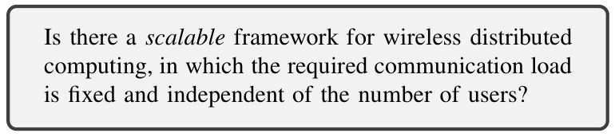
1. INTRODUCTION
移动设备上的大计算量的应用(地图服务，声音/图像识别，增强现实)近来发展迅速。
无线分布式计算框架(wireless distributed computing framework)将这些应用的计算任务分散到移动设备上，并要求一个无线设备集群要同时协助的完成各自的工作。
每个边缘设备不能完整的存储整个数据库。但是在无线分布式计算框架中，节点的协作可以完成基于整个数据集的任务。
设计一个scalable wireless distributed computing framework，最大的挑战就是各个节点之间显著的传输量。与有线传输相比，基于无线介质的传输资源更少，因此更容易达到传输瓶颈。

Slide 5
1. INTRODUCTION
To develop such a framework, we exploit three opportunities in conjunction:
Side-Information: When a sub-task has been processed in more than one node, the resulting intermediate outcomes will be available in all those nodes as side-information. This provides some opportunities for coding across the results and creates packets that are useful for multiple nodes.
Coding: We use coding to develop packets useful to more than one mobile users. This allows us to exploit the multicasting environment of the wireless medium and save communication overhead.
Multicasting: Wireless medium by nature is a multicasting environment. It means that when a signal is transmitted, it can be heard by all the nodes. We exploit this phenomenon by creating and transmitting signals that help several user nodes simultaneously.

Slide 6
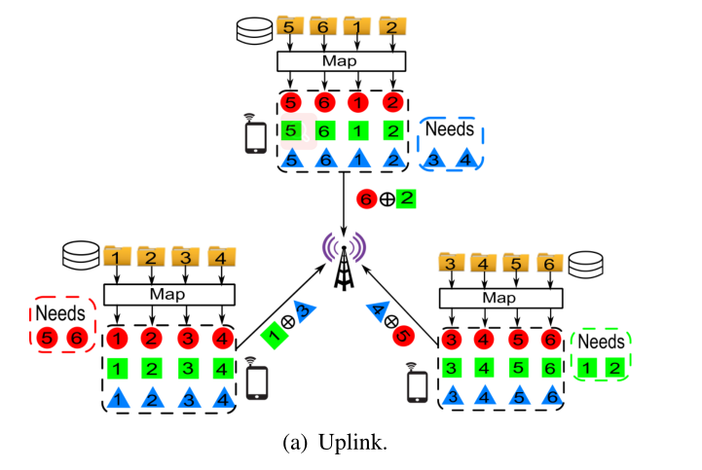
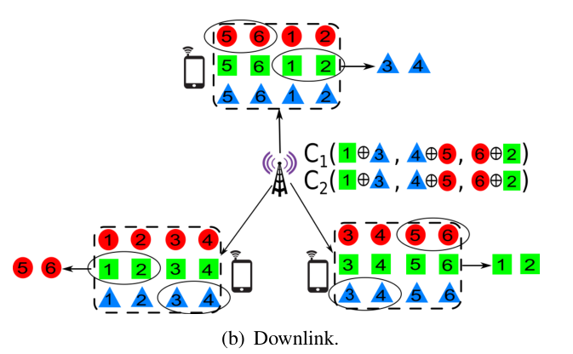
1. INTRODUCTION(Motivating Example,N=6,K=3,Q=3)
每一个文件都将产生Q=3个中间值
广播μK=2个线性组合
传统情况下，uplink阶段产生6个中间值，downlink阶段产生6个中间值，L=12
用coded思想，uplink产生3个中间值大小的数据，downlink阶段产生2个中间值大小的数据，L=5

Slide 7
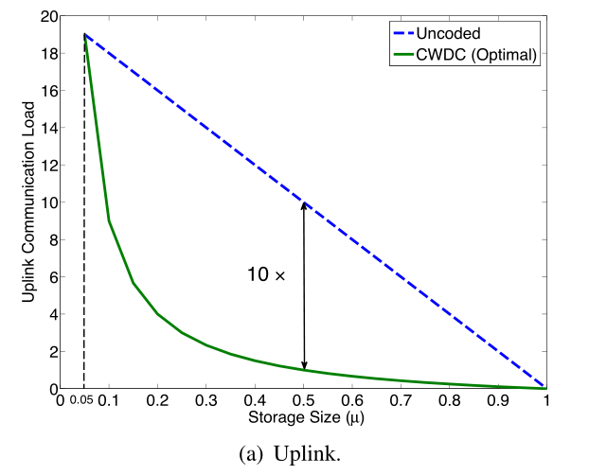
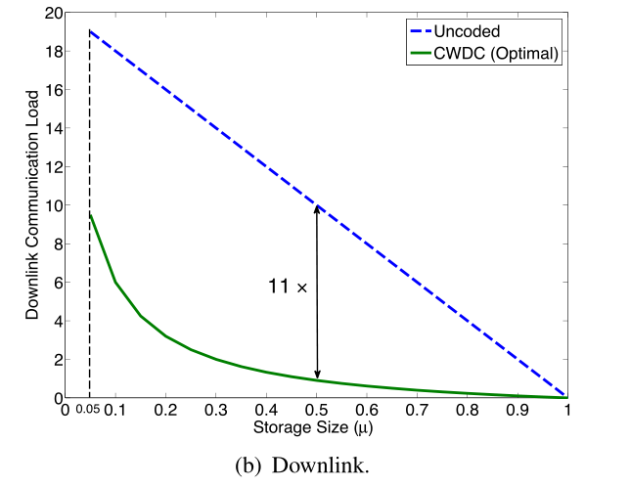
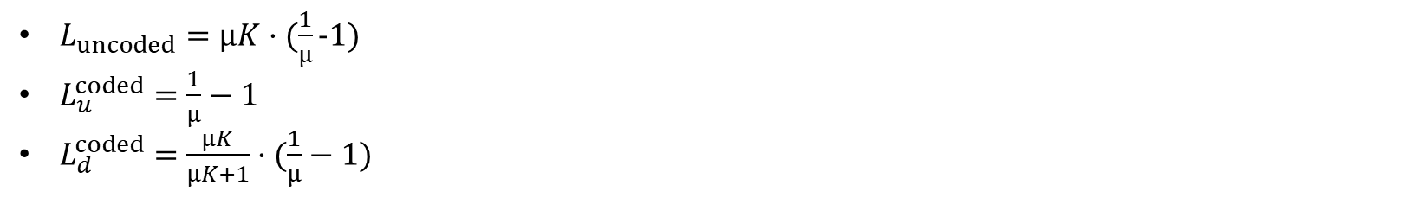
1. INTRODUCTION(Motivating Example,N=6,K=3,Q=3)
$L_{uncoded}=μK·(\frac{1}{μ}−1)$
$L_{u}^{coded}=$ $\frac{1}{μ}−1$
$L_{d}^{coded}=$ $\frac{μK}{μK+1}·(\frac{1}{μ}−1)$

Slide 8
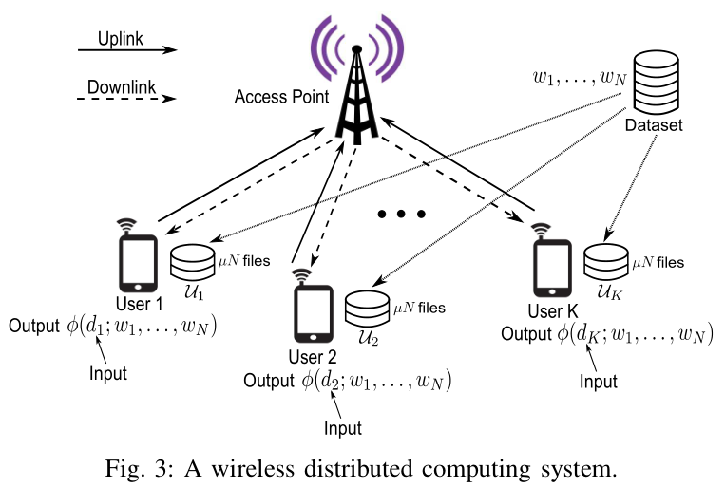
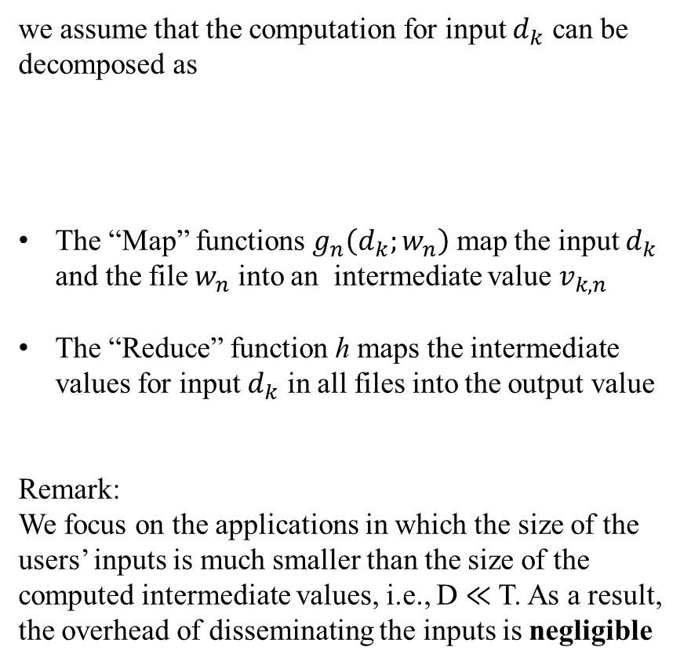
2. SYSTEM MODEL
we assume that the computation for input $d_{k}$ can be decomposed as
The “Map” functions $g_{n}\left(d_{k};w_{n}\right)$ map the input $d_{k}$ and the file $w_{n}$ into an intermediate value $v_{k,n}$
The “Reduce” function h maps the intermediate values for input $d_{k}$ in all files into the output value
Remark:
We focus on the applications in which the size of the
users’ inputs is much smaller than the size of the computed intermediate values, i.e., D ≪ T. As a result, the overhead of disseminating the inputs is negligible

Slide 9
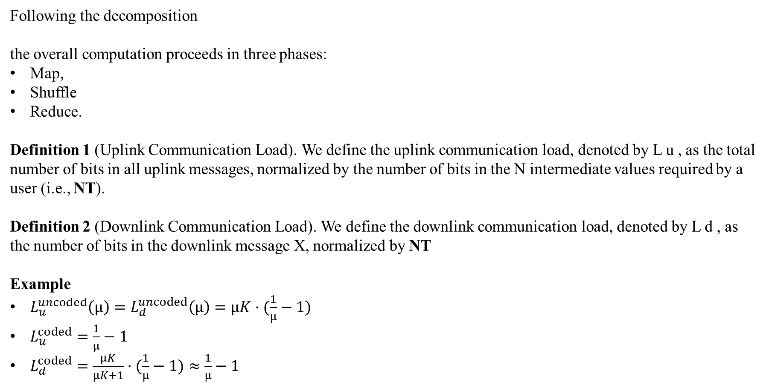
2. SYSTEM MODEL
Following the decomposition
the overall computation proceeds in three phases:
Map,
Shuffle
Reduce.
Definition 1 (Uplink Communication Load). We define the uplink communication load, denoted by L u , as the total number of bits in all uplink messages, normalized by the number of bits in the N intermediate values required by a user (i.e., NT).
Definition 2 (Downlink Communication Load). We define the downlink communication load, denoted by L d , as the number of bits in the downlink message X, normalized by NT
Example
$L_{u}^{uncoded}\left(μ\right)=L_{d}^{uncoded}\left(μ\right)=μK·(\frac{1}{μ}−1)$
$L_{u}^{coded}=$ $\frac{1}{μ}−1$
$L_{d}^{coded}=$ $\frac{μK}{μK+1}·(\frac{1}{μ}−1)≈$ $\frac{1}{μ}−1$

Slide 10

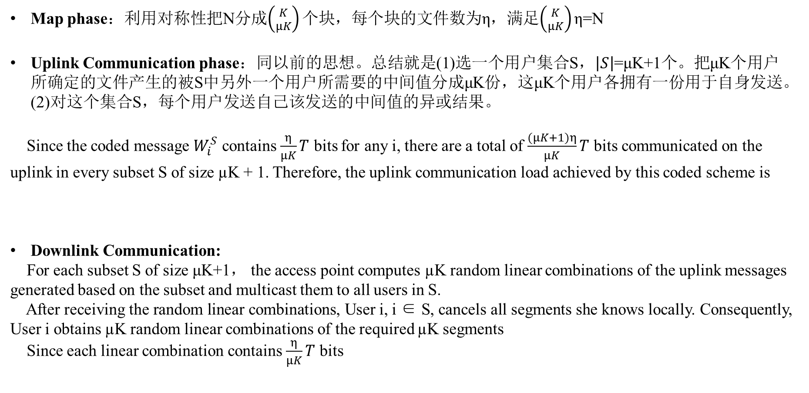
3. THE PROPOSED CWDC SCHEME
Map phase：利用对称性把N分成$\left({K \atop μK}\right)个$块，每个块的文件数为η，满足$\left({K \atop μK}\right)$ η=N
Uplink Communication phase：同以前的思想。总结就是(1)选一个用户集合S，$\left|S\right|$=μK+1个。把μK个用户所确定的文件产生的被S中另外一个用户所需要的中间值分成μK份，这μK个用户各拥有一份用于自身发送。(2)对这个集合S，每个用户发送自己该发送的中间值的异或结果。
Since the coded message $W_{i}^{S}$ contains $\frac{η}{μK}T$ bits for any i, there are a total of $\frac{(μK+1)η}{μK}T$ bits communicated on the uplink in every subset S of size µK + 1. Therefore, the uplink communication load achieved by this coded scheme is
Downlink Communication:
For each subset S of size μK+1， the access point computes µK random linear combinations of the uplink messages generated based on the subset and multicast them to all users in S.
After receiving the random linear combinations, User i, i ∈ S, cancels all segments she knows locally. Consequently, User i obtains µK random linear combinations of the required µK segments
Since each linear combination contains $\frac{η}{μK}T$ bits

Slide 11
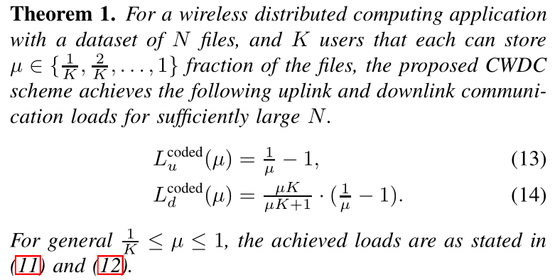
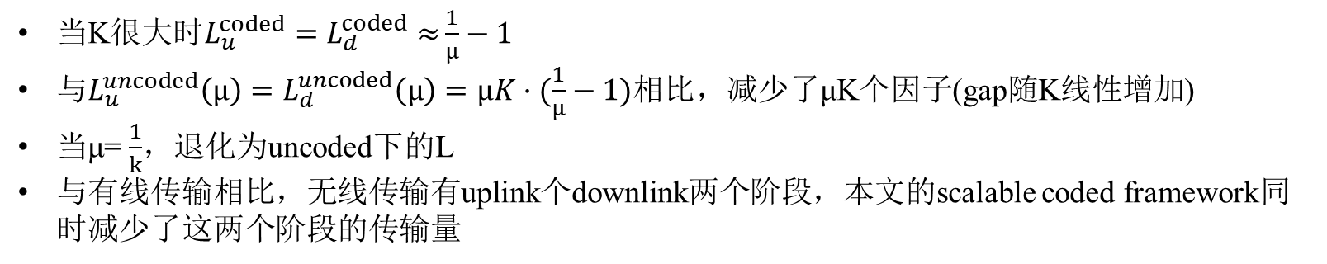
3. THE PROPOSED CWDC SCHEME
当K很大时$L_{u}^{coded}=L_{d}^{coded}≈$ $\frac{1}{μ}−1$
与$L_{u}^{uncoded}\left(μ\right)=L_{d}^{uncoded}\left(μ\right)=μK·(\frac{1}{μ}−1)$相比，减少了μK个因子(gap随K线性增加)
当μ= $\frac{1}{k}$，退化为uncoded下的L
与有线传输相比，无线传输有uplink个downlink两个阶段，本文的scalable coded framework同时减少了这两个阶段的传输量

Slide 12

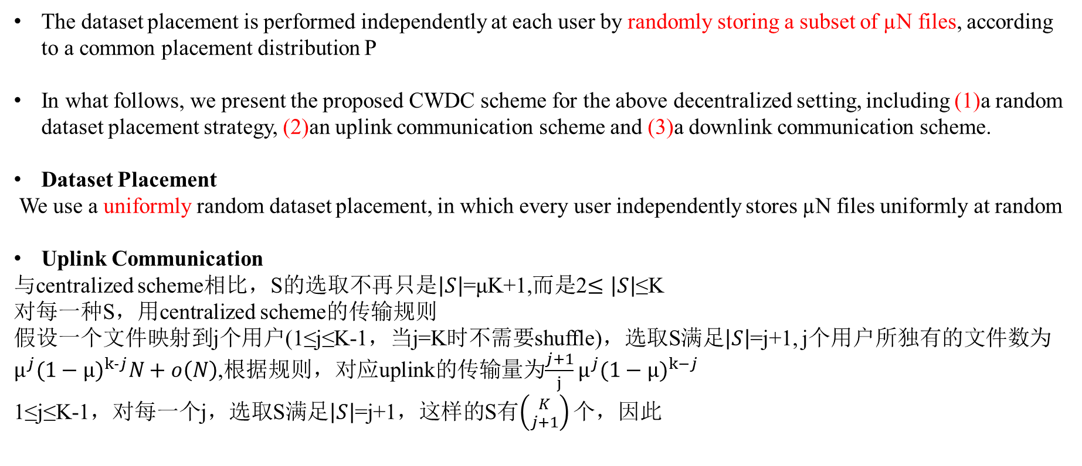
4. THE PROPOSED CWDC SCHEME FOR THE DECENTRALIZED SETTING
The dataset placement is performed independently at each user by randomly storing a subset of µN files, according to a common placement distribution P
In what follows, we present the proposed CWDC scheme for the above decentralized setting, including (1)a random dataset placement strategy, (2)an uplink communication scheme and (3)a downlink communication scheme.
Dataset Placement
We use a uniformly random dataset placement, in which every user independently stores µN files uniformly at random
Uplink Communication
与centralized scheme相比，S的选取不再只是$\left|S\right|$=μK+1,而是2$≤\left|S\right|$≤K
对每一种S，用centralized scheme的传输规则
假设一个文件映射到j个用户(1≤j≤K-1，当j=K时不需要shuffle)，选取S满足$\left|S\right|$=j+1, j个用户所独有的文件数为$μ^{j}{(1−μ)}^{k−j}N+o\left(N\right)$,根据规则，对应uplink的传输量为$\frac{j+1}{j}μ^{j}{(1−μ)}^{k−j}$
1≤j≤K-1，对每一个j，选取S满足$\left|S\right|$=j+1，这样的S有$\left({K \atop j+1}\right)$ 个，因此

Slide 13
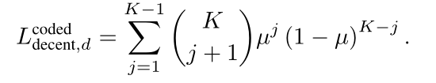
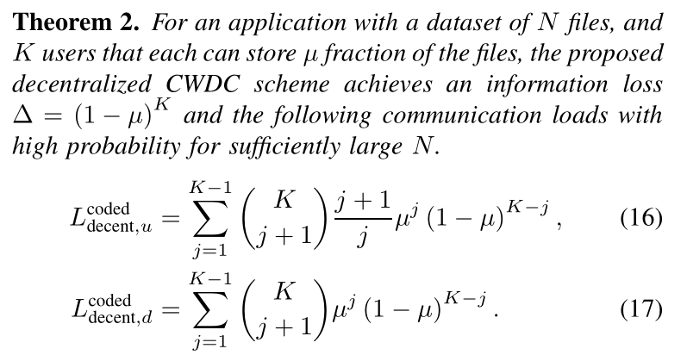
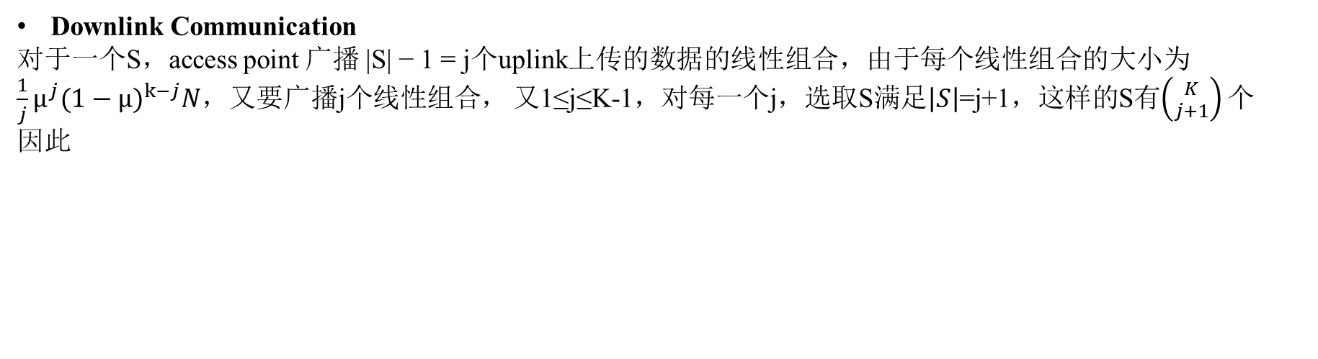
4. THE PROPOSED CWDC SCHEME FOR THE DECENTRALIZED SETTING
Downlink Communication
对于一个S，access point 广播 |S| − 1 = j个uplink上传的数据的线性组合，由于每个线性组合的大小为$\frac{1}{j}μ^{j}{(1−μ)}^{k−j}N$，又要广播j个线性组合， 又1≤j≤K-1，对每一个j，选取S满足$\left|S\right|$=j+1，这样的S有$\left({K \atop j+1}\right)$ 个
因此
As K becomes large, the information loss achieved by the decentralized CWDC approaches 0
Information loss Δ is the fraction of the files that are not stored by any participating user.

Slide 14
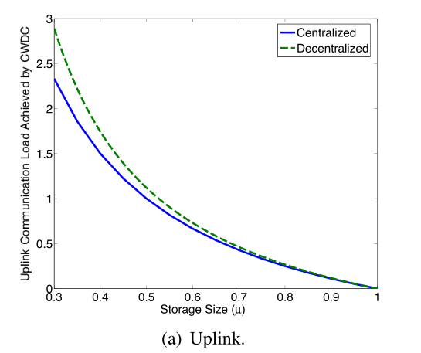
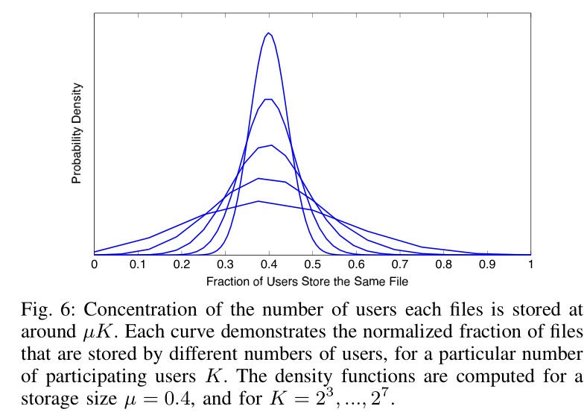
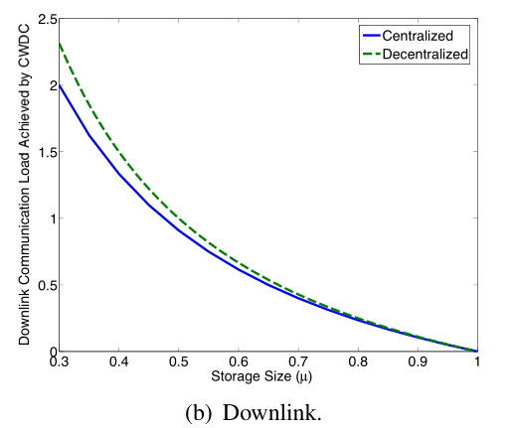
4. THE PROPOSED CWDC SCHEME FOR THE DECENTRALIZED SETTING
分配规则：每个用户随机的分得μN个文件
上图表示每一个文件同时映射到μK个用户的概率密度函数

Slide 15
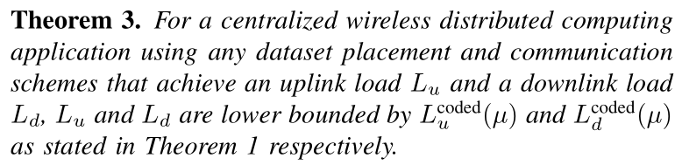
5. OPTIMALITY OF THE PROPOSED CWDC SCHEMES
Remark：Using Theorem 1 and 3, we have completely characterized the minimum achievable uplink and downlink communication loads, using any dataset placement, uplink and downlink communication schemes for the centralized setting. This implies that the proposed centralized CWDC scheme simultaneously minimizes both uplink and downlink communication loads required to accomplish distributed computing, and no other scheme can improve upon it.

Slide 16
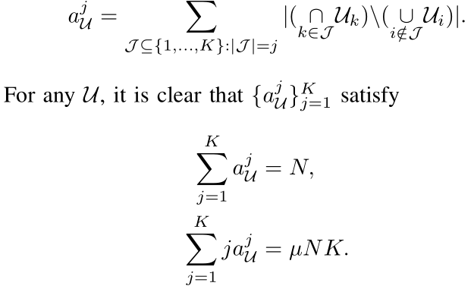

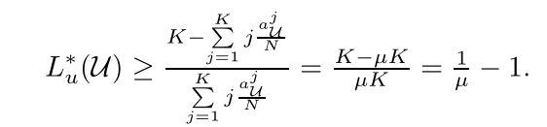
5. OPTIMALITY OF THE PROPOSED CWDC SCHEMES
Lower Bound on $L_{u}^{∗}(U)$
For a given dataset placement U, we denote the number of files that are stored at j users as $a_{U}^{j}$，for all j∈{1,…,K}
不等式右边是关于j的凸函数，用jensen不等式

Slide 17



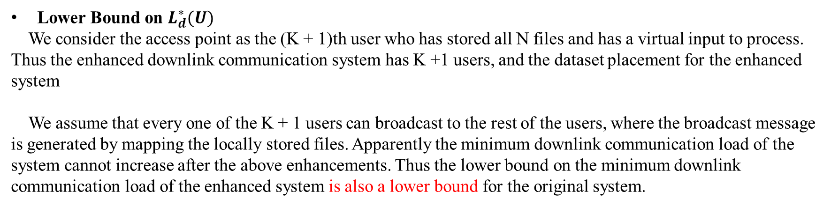
5. OPTIMALITY OF THE PROPOSED CWDC SCHEMES
Lower Bound on $L_{d}^{∗}(U)$
We consider the access point as the (K + 1)th user who has stored all N files and has a virtual input to process.
Thus the enhanced downlink communication system has K +1 users, and the dataset placement for the enhanced system
We assume that every one of the K + 1 users can broadcast to the rest of the users, where the broadcast message is generated by mapping the locally stored files. Apparently the minimum downlink communication load of the system cannot increase after the above enhancements. Thus the lower bound on the minimum downlink communication load of the enhanced system is also a lower bound for the original system.
不等式右边是关于j的凸函数，用jensen不等式

Slide 18
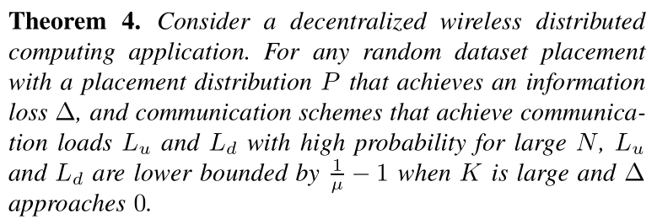

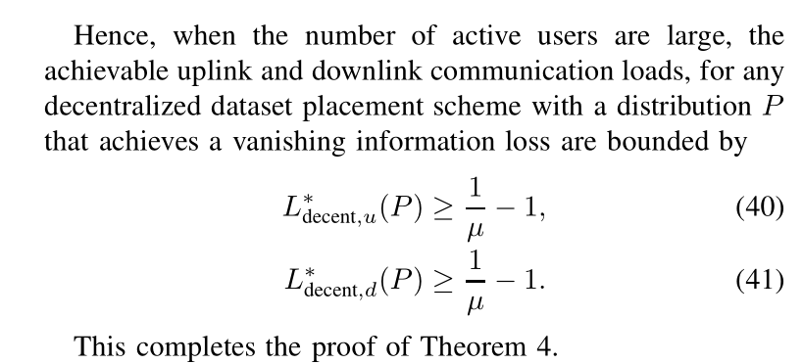
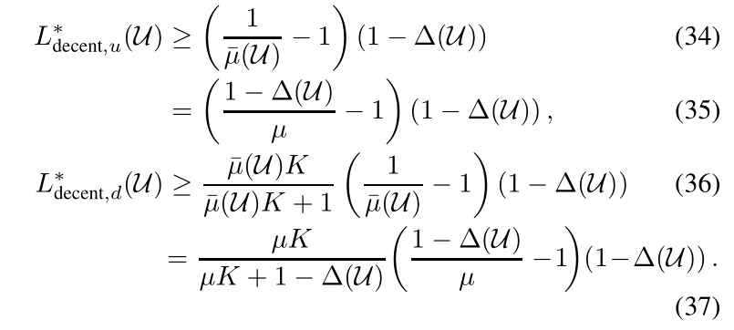
5. OPTIMALITY OF THE PROPOSED CWDC SCHEMES
给定一个信息损失Δ(U)=(1-μ)^k，1-Δ(U)部分的文件都存在与用户的cache里面，也是需要用到的文件
在这些文件中 部分的文件将存储在每一个用户中，用$\overline{μ}$代替μ，结合信息损失Δ，带入centralized 公式中
Δ=0

Slide 19
6. CONCLUSIONS AND FUTURE DIRECTIONS
本文提出了一种可扩展的基于编码的无线分布式计算框架CWDC用于减少unlink和downlink的传输量，并同时对centralized scheme和decentralized scheme进行分析。本文算法下的L是个常量，不会随着K的增加而线性增加。
未来的工作
Network Heterogeneity
比如不同移动设备链路质量、处理能力、电池容量等不同。当不同设备链路容量不同，一种方法是分组思想把链路容量相近的用户放到一个组里，然后每个组分别用本文的scheme。但是分组的策略是open question。
Computation Heterogeneity
指的是中间值的size不相同，这种情况下coding operations将不再对称(将对不同size的数据进行xor运算)。或者，用一个placement方法在尽可能多的用户中产生最大的coded multicasting opportunities。但是placement 策略和传输策略是open question。
Straggling/Failing Users
无线传输下依然会出现straggler问题，用MDS码解决
Multi-Stage Computation
目前考虑的是一级的mapreduce结构，如果是多级的情况(有向无环图)下的传输策略将是感兴趣的question

